Slide 1


Export Tool
Humanitarian OpenStreetMap Team
Mhairi O’Hara (@MapNut_)

Slide 2

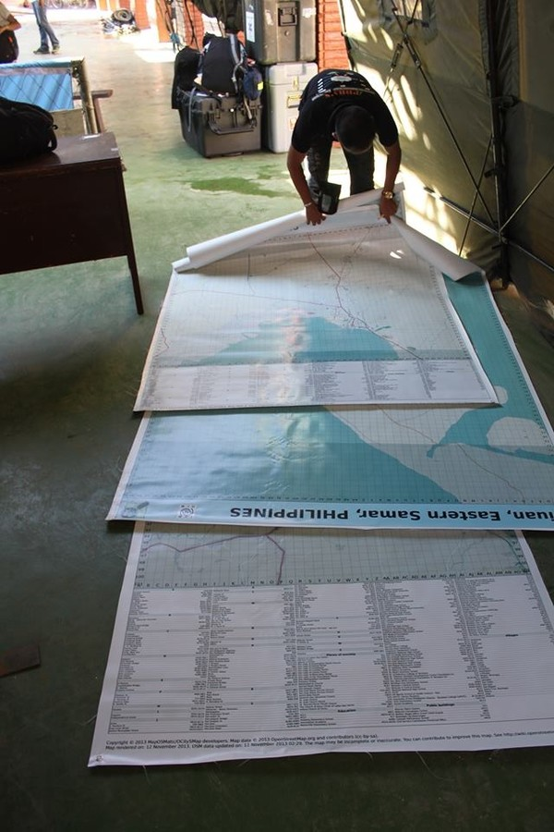
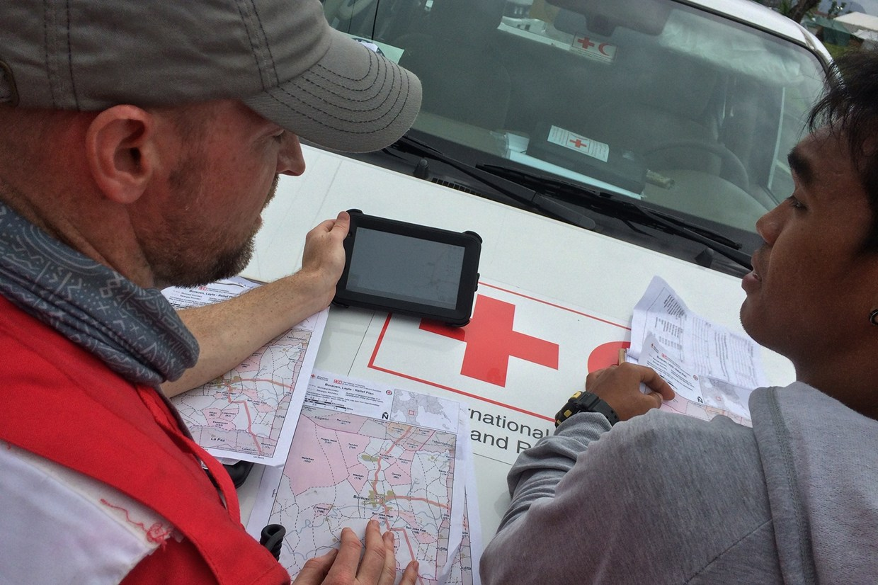
What is the Humanitarian OpenStreetMap Team?
During a crisis, disaster or epidemic, maps are crucial to help responders

Slide 3

Maps Help
Checklist:
...
Identify areas of high population
(building density)
Locate suitable areas for response command posts, shelter and aid provision
Navigate access routes and safe roads in affected areas

Slide 4
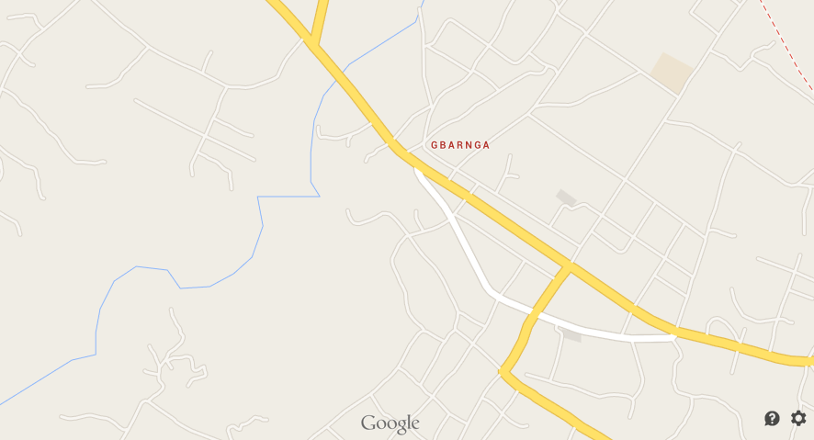
Gbarnga, Liberia
Not Everywhere is Mapped
- or has Accessible Maps

Slide 5
The Humanitarian OpenStreetMap Team helps solve this problem by coordinating public efforts
- to map and label areas affected by disasters

Slide 6
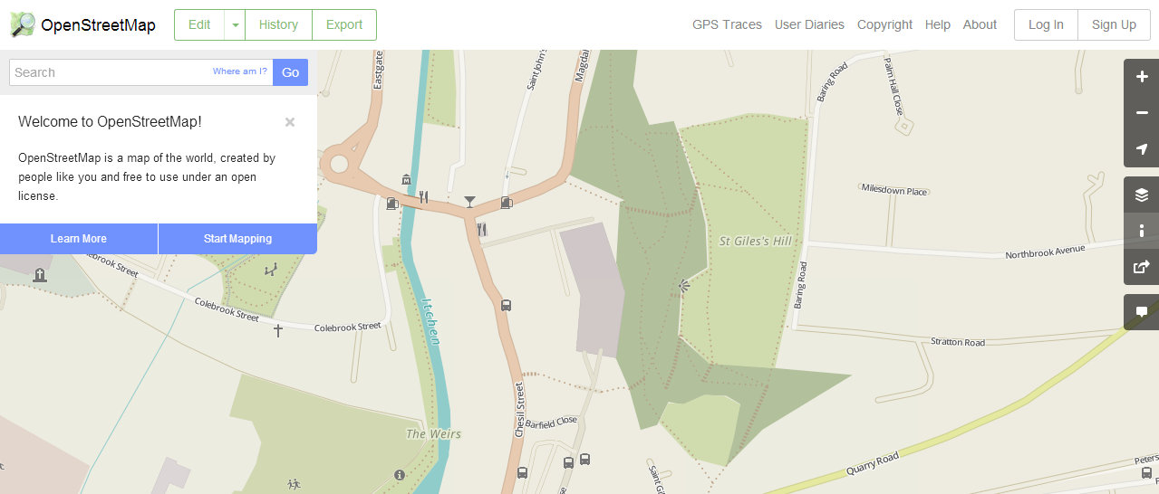
This collective mapping - or the ‘crowdsourcing’ of geographic information began in 2004
OpenStreetMap

Slide 7
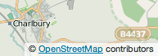
Created by people for the people
- Wikipedia of Maps!
Open Database License (ODbL)
Can be used in apps, online maps, and printable maps for free - as long as the contributors are credited

Slide 8
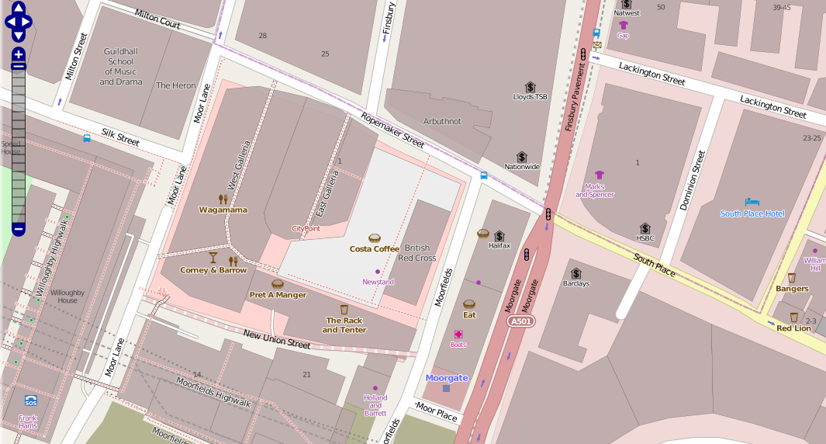
So whilst it has many similarities to the mapping applications you use in your day-to-day life...

Slide 9
Everyone Creates, Updates and Maintains OSM Data
OpenStreetMap Mapathon!
Whether at home, on a train, at a cafe with friends, or at a mapathon...

Slide 10
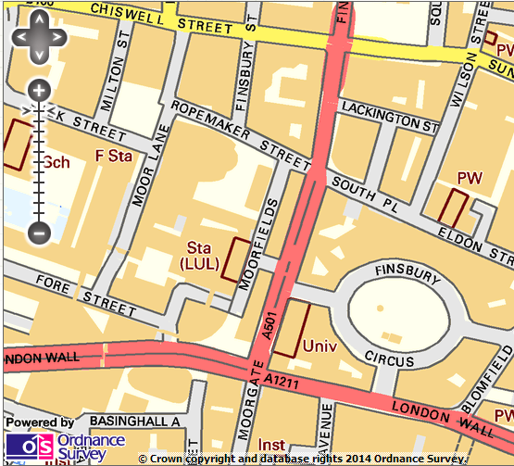
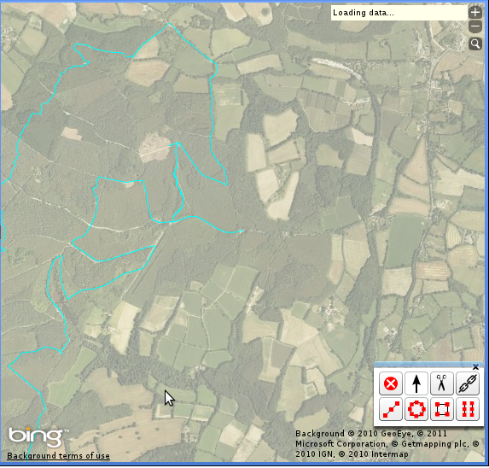
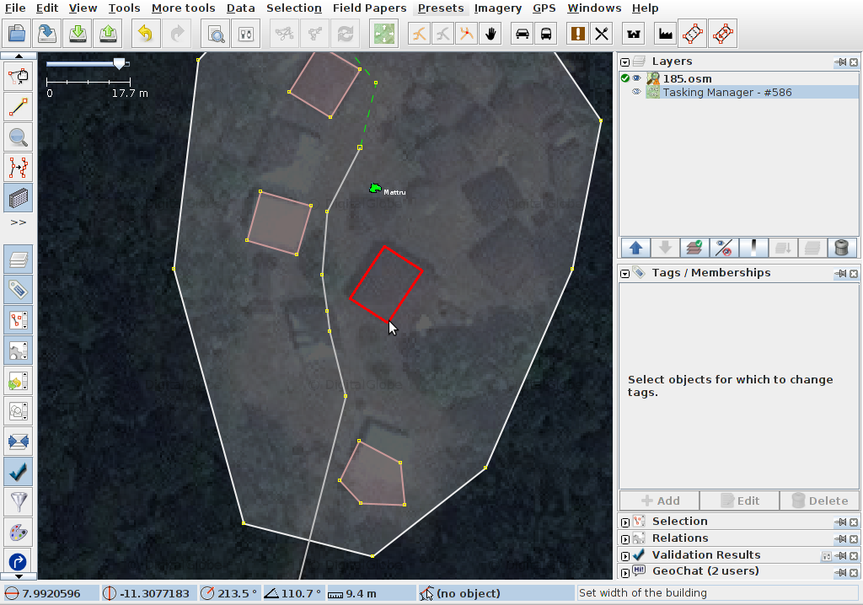
Ways to Contribute to OSM
Image: Snapshot of Ordnance Survey Open Data
© Crown Coyrght
Image: HOT User/Apapadop
Image: HOT User/Tall Guy
1. By adding open datasets to OSM
2. By adding GPS/GPX tracks to OSM
3. By digitising satellite imagery

Slide 11
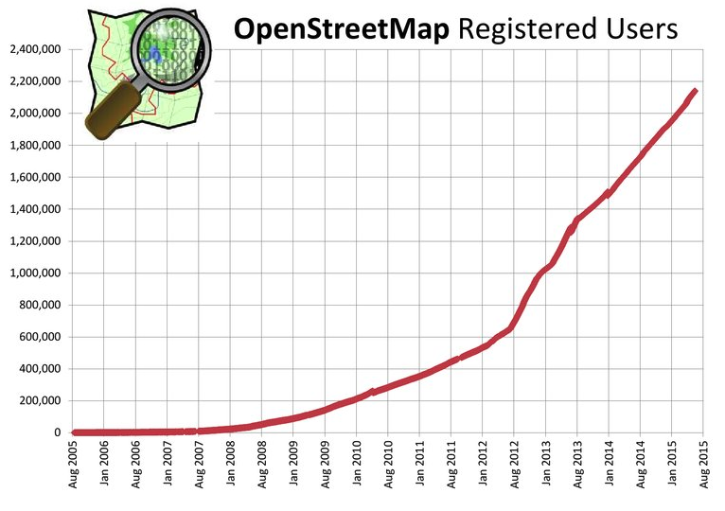
OSM now has over 2 million registered users

Slide 12
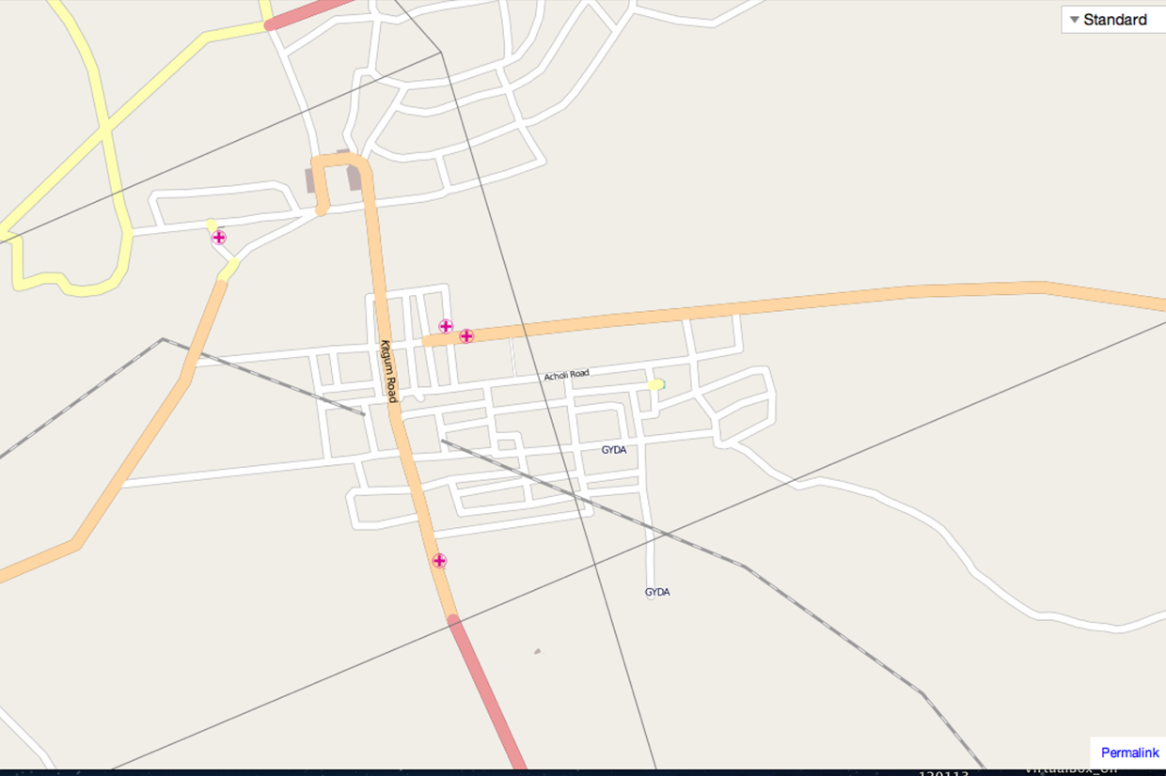
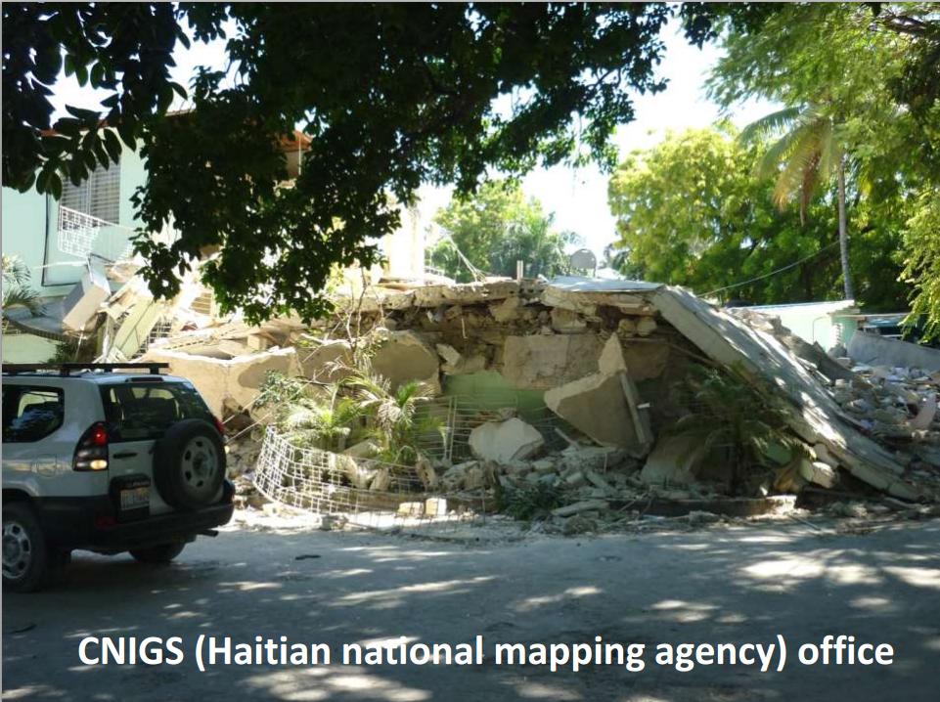
Adding to the Map is Crucial
for HOT
Haiti’s national mapping agency office and many maps were destroyed in the earthquake, which also killed 6 workers who were prominent Haitian geographers.
Gulu, Uganda before the Ebola crisis.
Often affected areas do not have adequate, up-to-date, or accessible data or maps

Slide 13
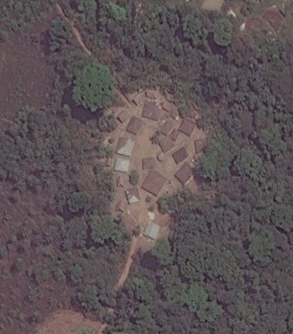
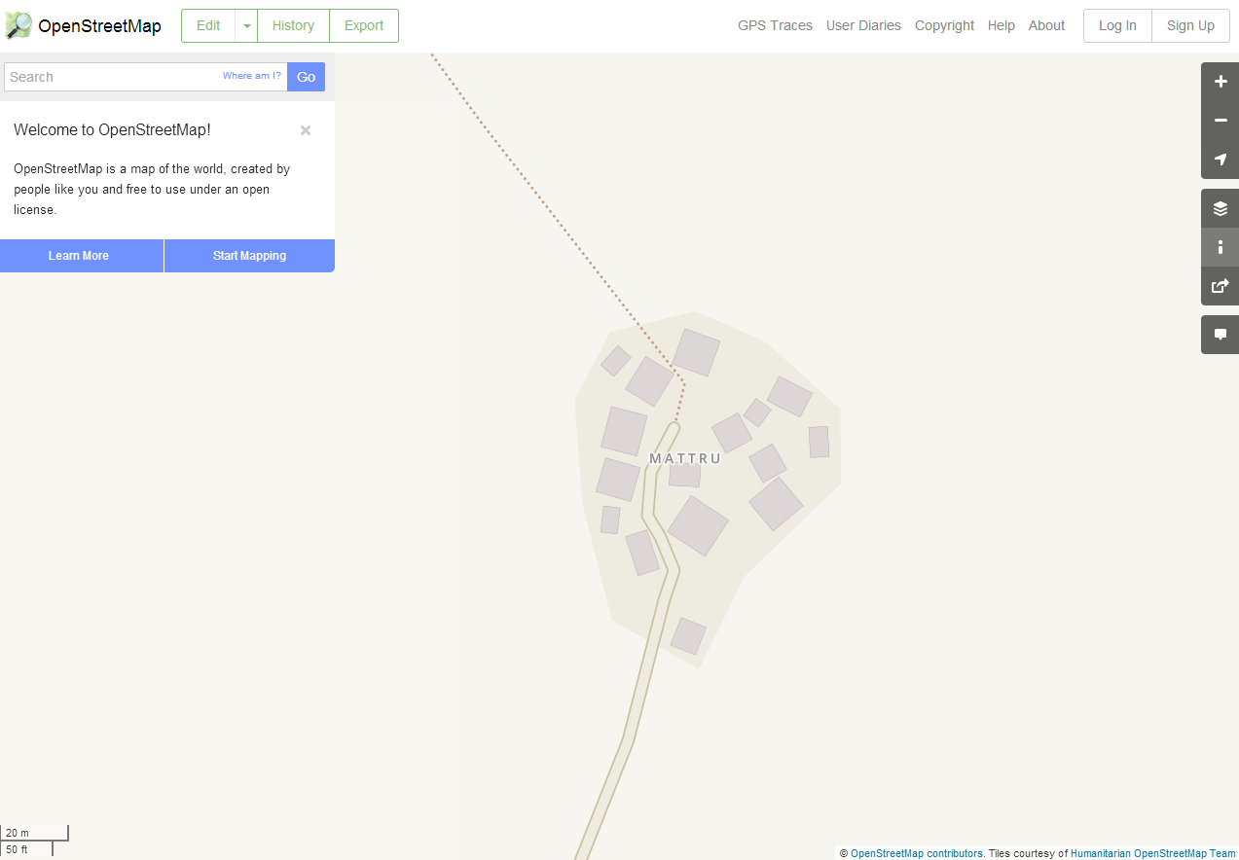
HOT responses predominantly require mappers to digitise satellite imagery
Obtain up-to-date satellite imagery for the area
Digitise roads, tracks, paths, building, open areas, waterways, etc
Upload the data and see the changes

Slide 14
HOT harnesses the OSM volunteer community and coordinates the mapping of affected areas
Tasking Manager
HOT Mapathon!
HOT asks OSM community to help map affected area
Across the globe the HOT-OSM community map
Disaster occurs!

Slide 15
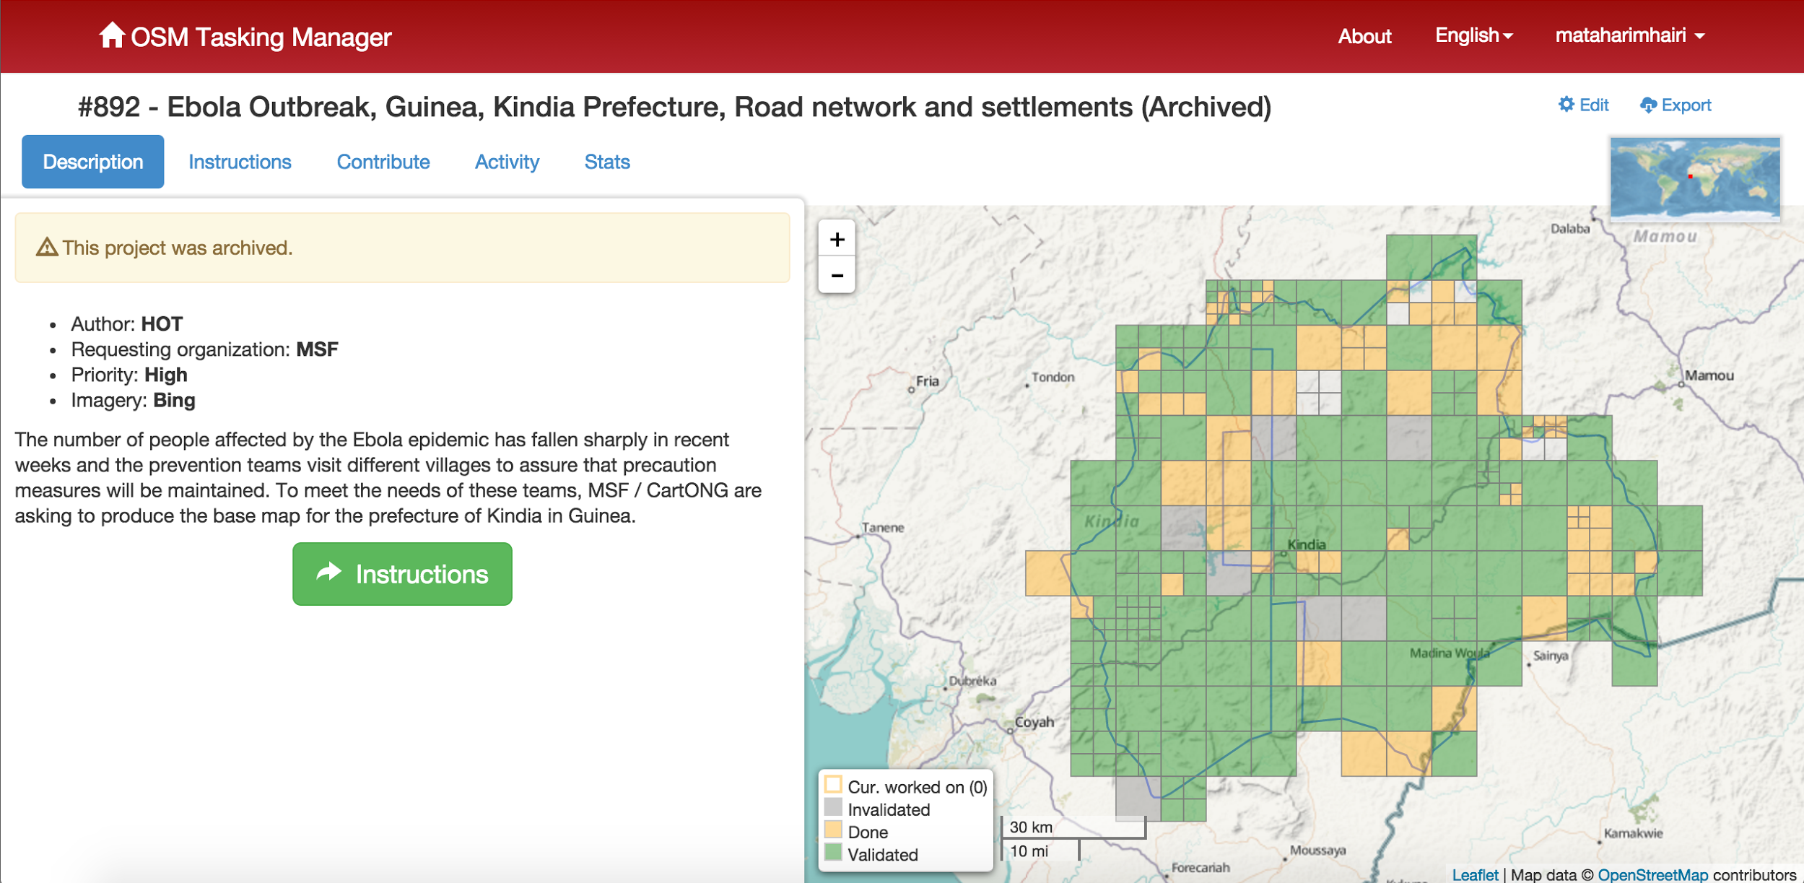
Tasking Manager
Coordinate the mapping of key features in
areas of interest in OSM
Notes:
How does it work?

Slide 16

Humanitarian arm (or branch) of OpenStreetMap

Slide 17
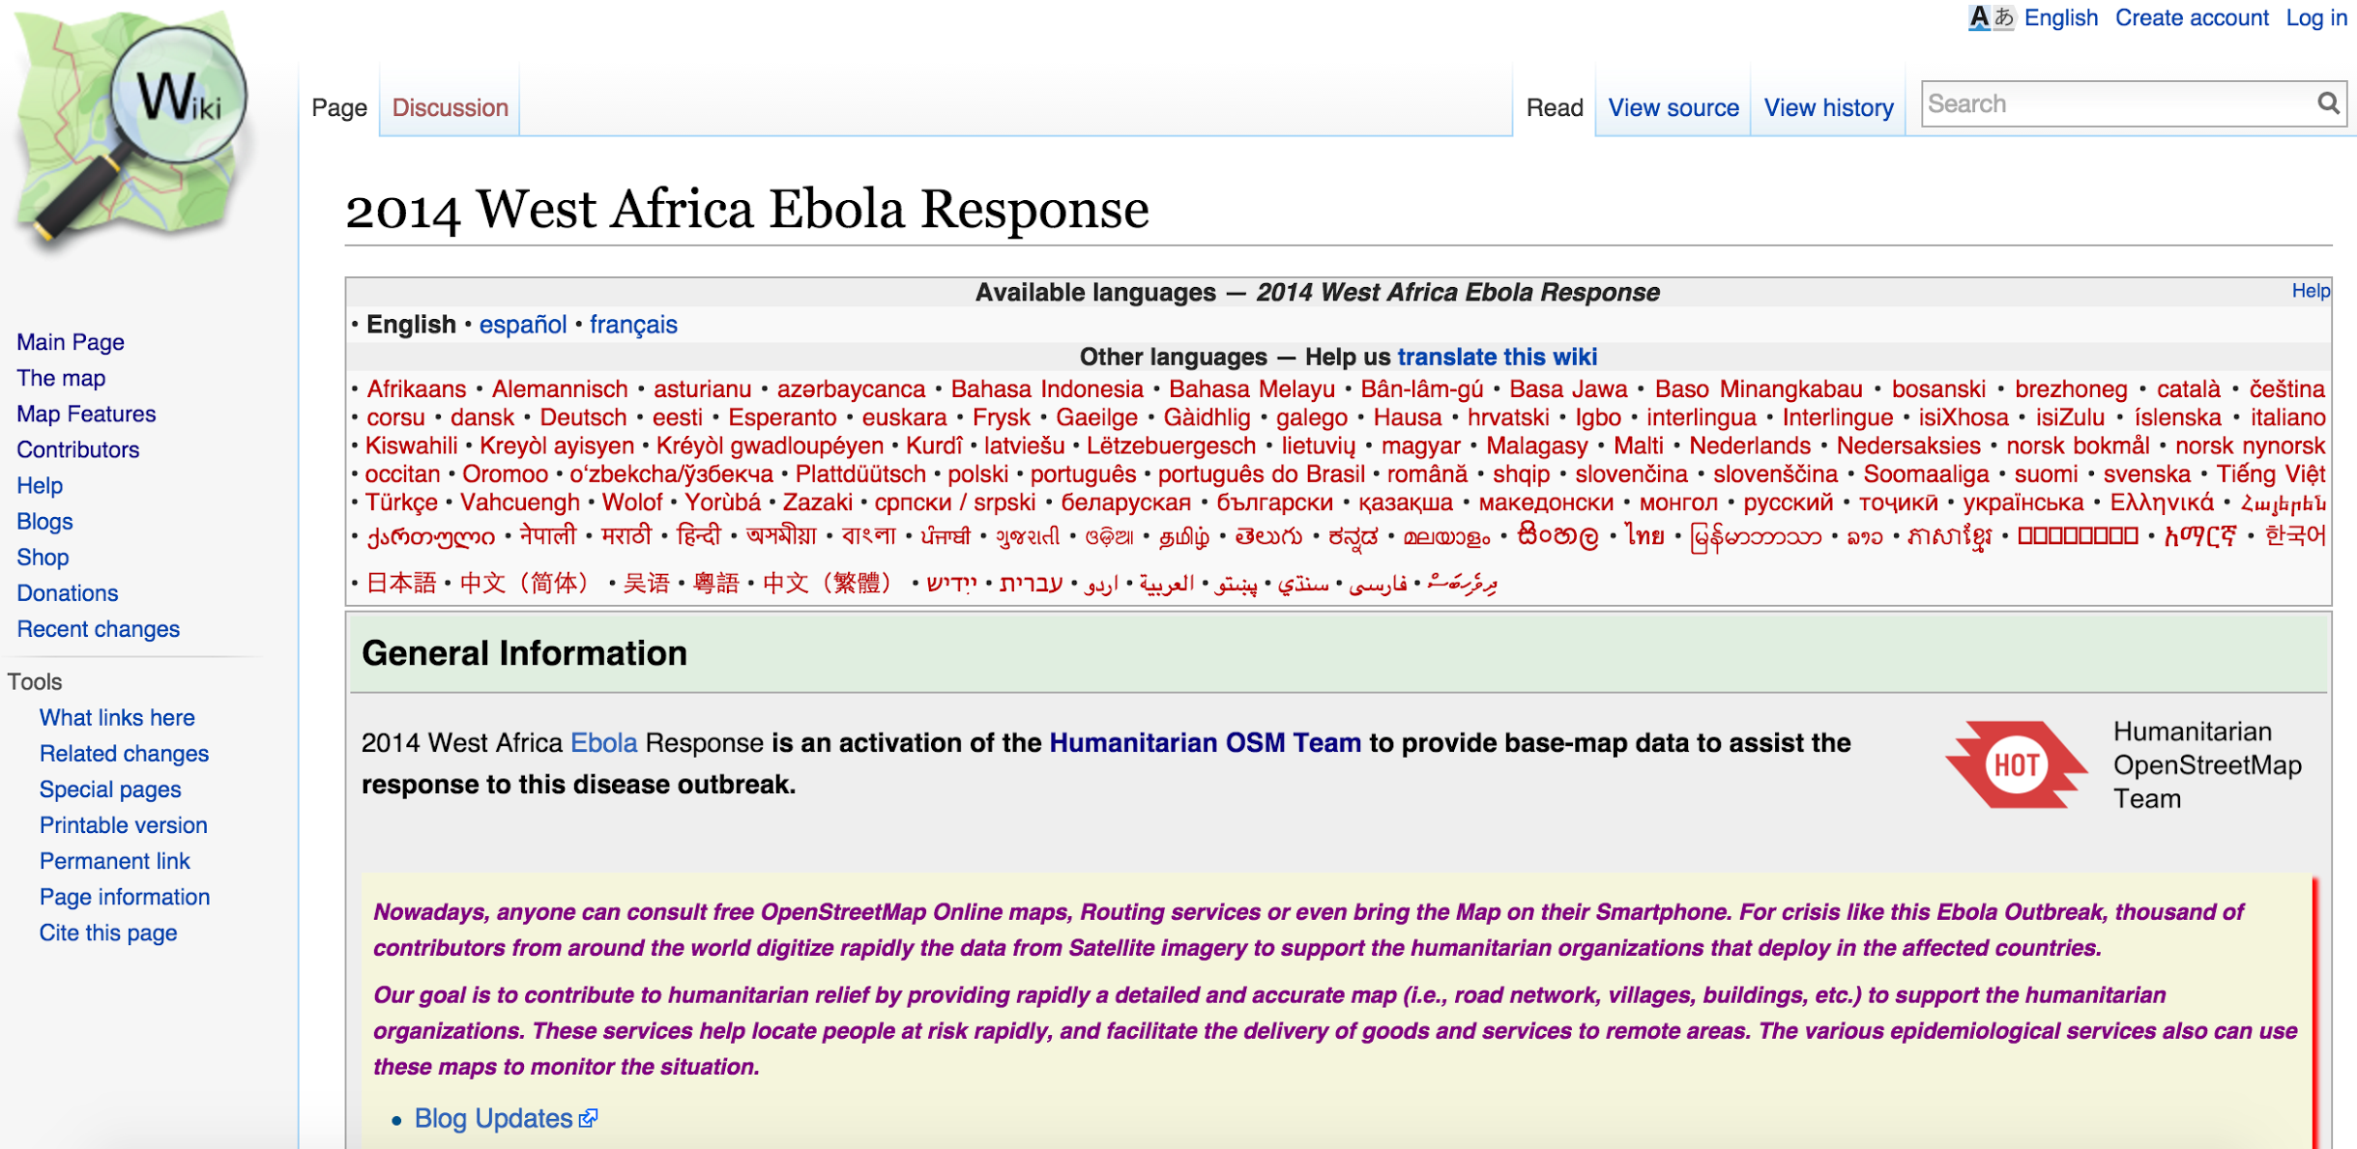
Activation OSM Wiki Page
Notes:
How does it work?

Slide 18
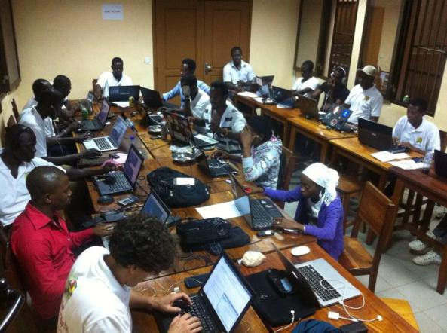
Mapathon
OpenStreetMap Togo
Notes:
Also a story of hope and togetherness - community. Tell you a story of how almost 4000 volunteers from over 100 countries came together to assist, with real impact on the ground.

Slide 19
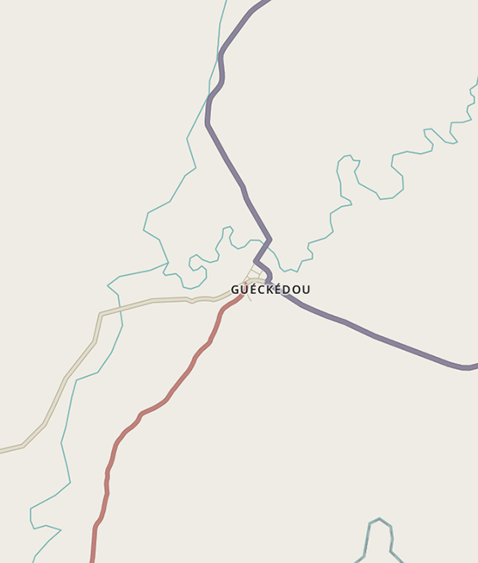
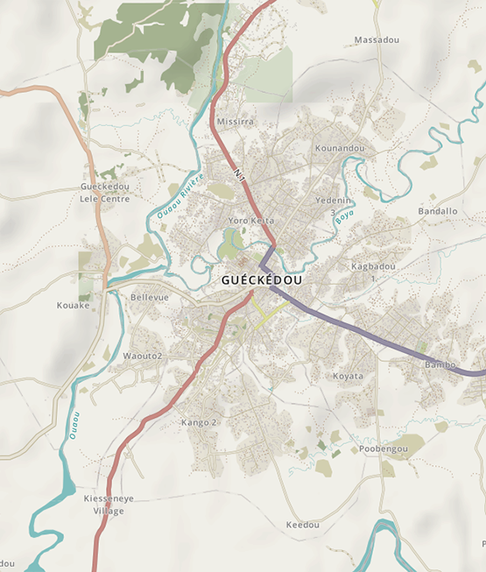
Before
After
Gueckedou, Guinea
(Within 5 days, 244 volunteers mapped
90,000+ buildings)
Notes:
Nearly 1mm objects edited in this timeframe (888,600)

Slide 20
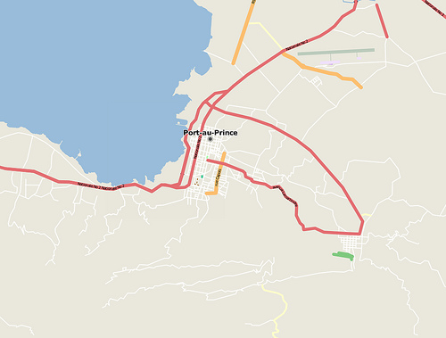
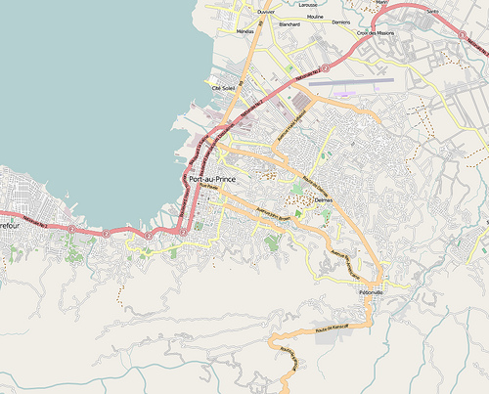
Port-au-Prince, Haiti
(2 days after the earthquake)
Before
After

Slide 21
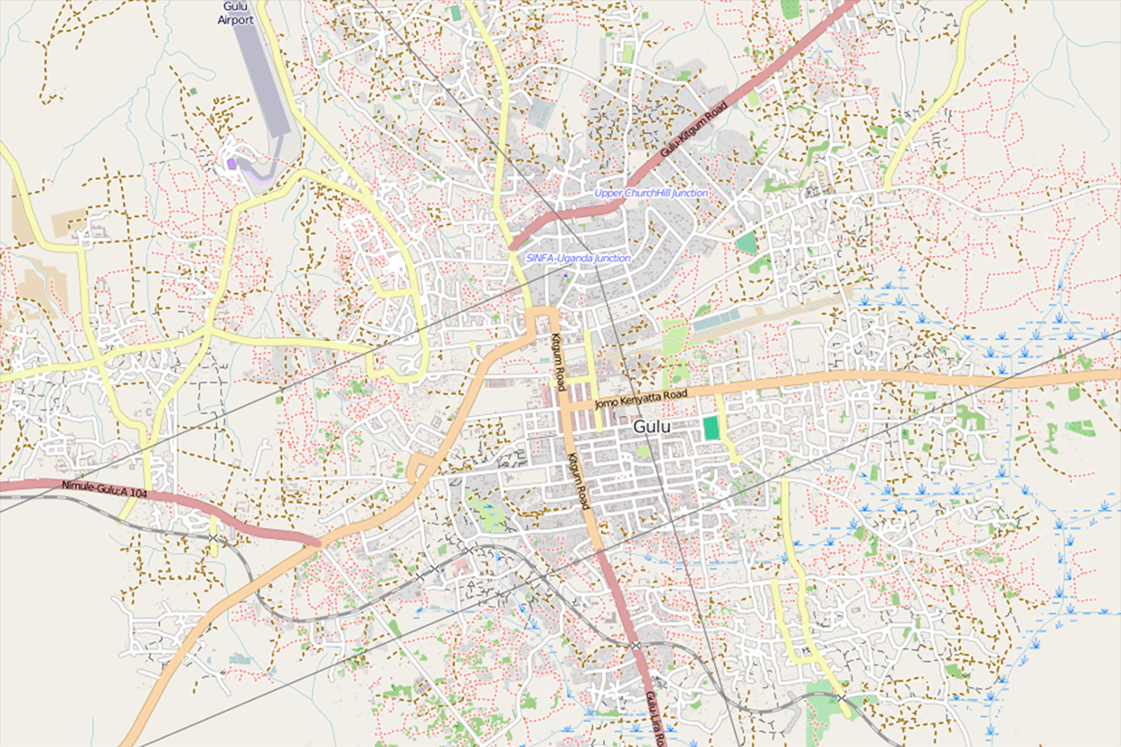
Gulu, Uganda
(HOT/American Red Cross Mapathon)
Before
After

Slide 22




So who is involved?
Create the data
Coordinate the data
Use the data
Community of enthusiast mappers, GIS professionals, engineers running the OSM servers
HOT is the bridge between the OSM community and the humanitarian organisations who use the data
Humanitarian organisations who are ‘in the field’ during the response use OSM data on ground to support their other activities
Notes:
add a slide on each

Slide 23
Humanitarian organisations request priority areas to be mapped
Tasking Manager
Additional Response
HOT Mapathon!
Disaster occurs!
HOT asks OSM community to help map affected area
HOT-OSM community focus their mapping
Humanitarian organisations contact HOT to refine and specify areas of key concern to map

Slide 24

Mamou, Guinea
29 hours
68 contributors
20,105 buildings
Notes:
Mamou tracing, courtesy Mapbox
In 29 hours 68 contributors mapped an entire city (20,105 buildings):

Slide 25

Once areas are mapped, data is used by organisations to respond
Humanitarian Organisations
HOT Mapathon!
HOT-OSM community map areas
Map data is held in the OSM database
Organisations use OSM data to plan and coordinate their response efforts

Slide 26
How do we get the data out of OpenStreetMap?
Humanitarian Organisations
?
HOT Mapathon!
?
?
HOT-OSM community map areas
Map data is held in the OSM database
Organisations use OSM data to plan and coordinate their response efforts

Slide 27
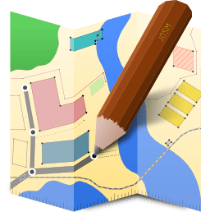


OpenStreetMap Tools
Overpass
Turbo
JOSM
QGIS

Slide 28



Disaster Mapping
2. Technical Projects
3. Community Development
Notes:
Nearly 1mm objects edited in this timeframe (888,600)

Slide 29
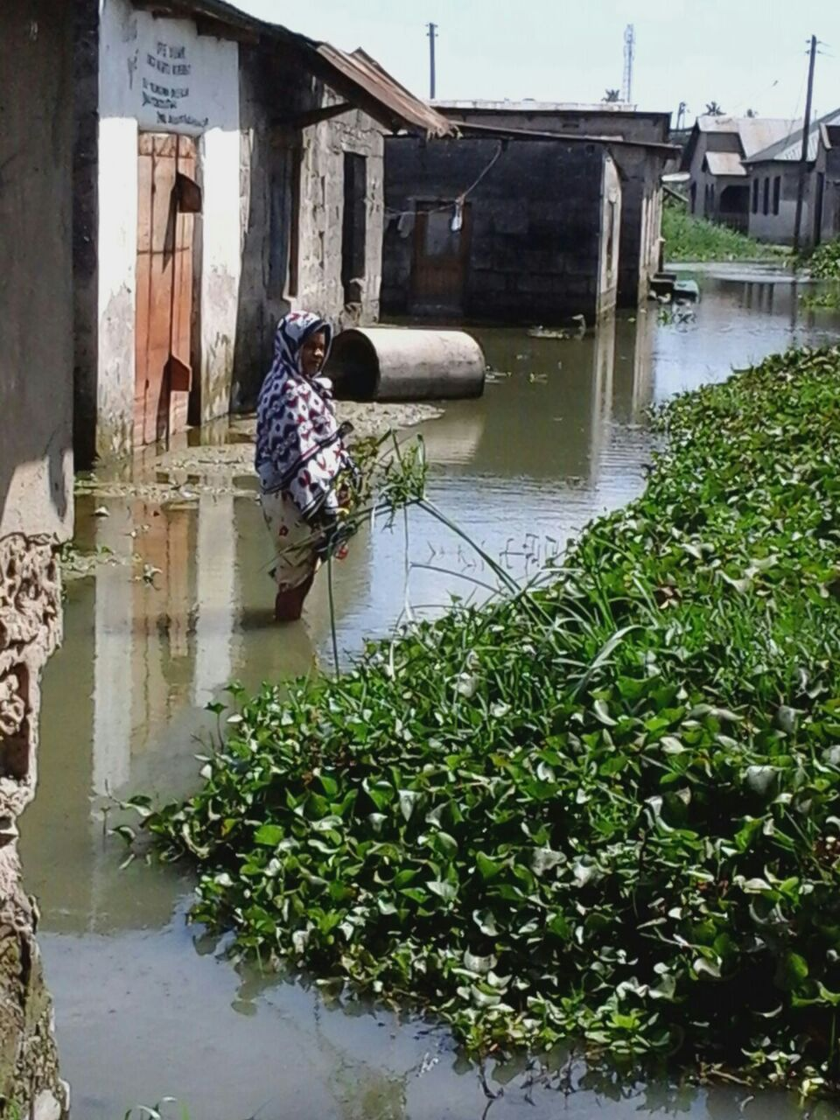
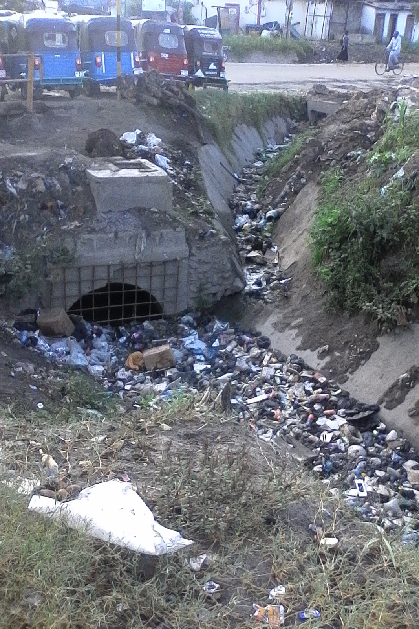
Dar es Salaam, Tanzania

Slide 30
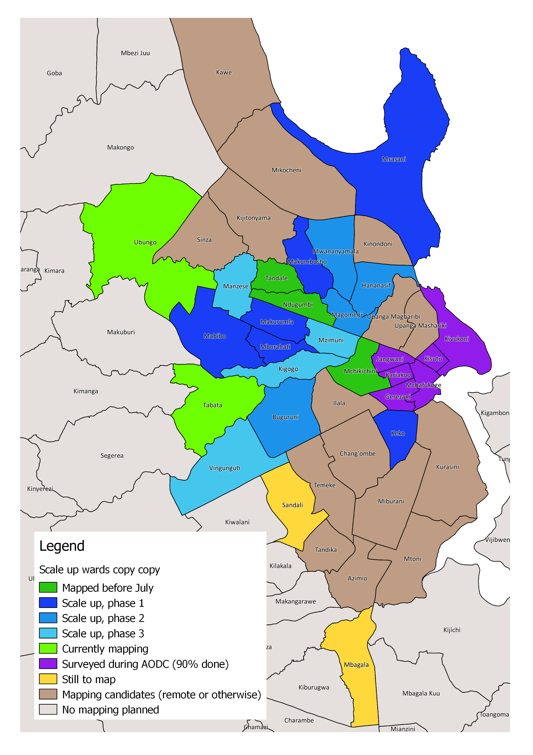

19 wards mapped, home to over 1 million people
over 500 km of waterways
250000 buildings
1200 school buildings

Slide 31
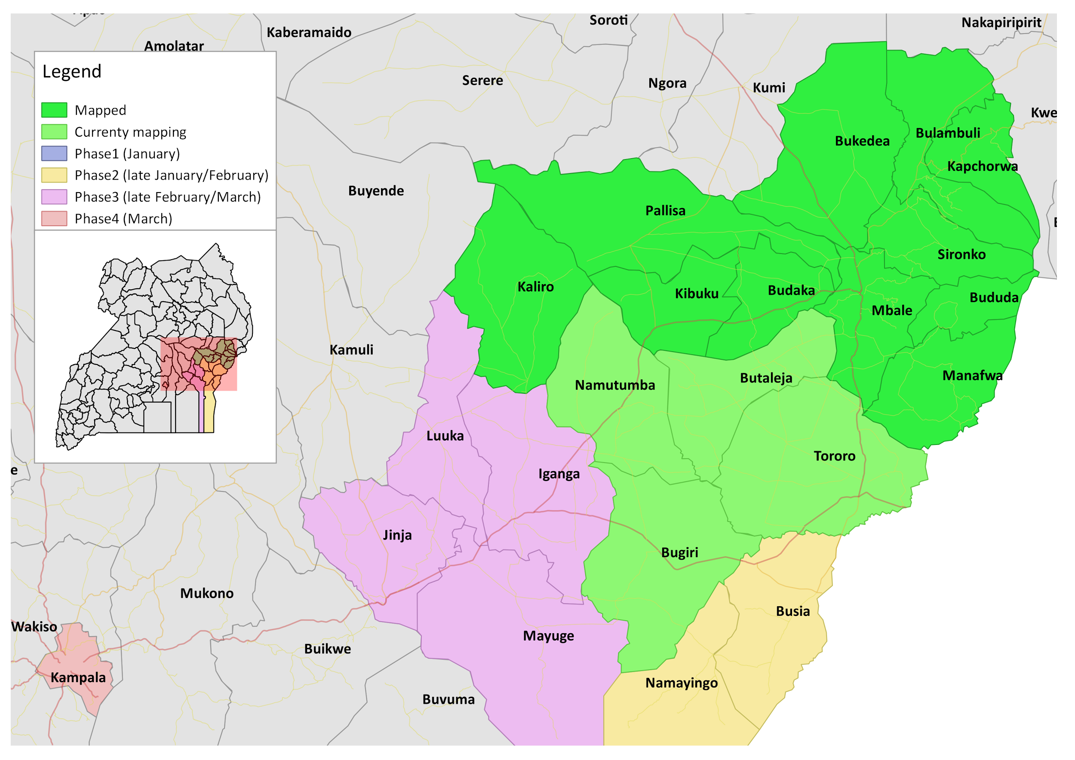
Eastern, Uganda

Slide 32




Financial Services

Slide 33
Disaster Mapping
2. Technical Projects
3. Community Development
Notes:
Nearly 1mm objects edited in this timeframe (888,600)

Slide 34
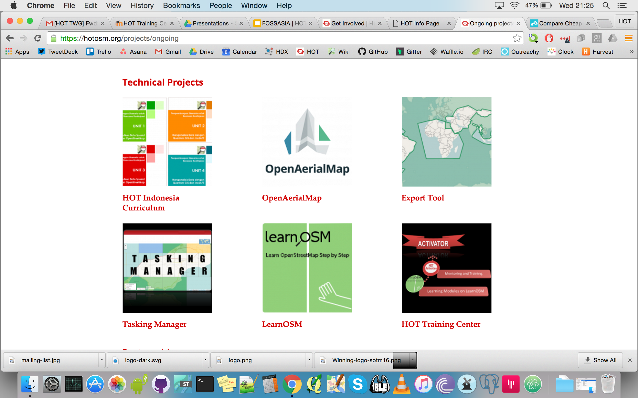
Tasking Manager
2. Data Analysis
3. Export Tool
4. OpenAerialMap
Notes:
Nearly 1mm objects edited in this timeframe (888,600)

Slide 35
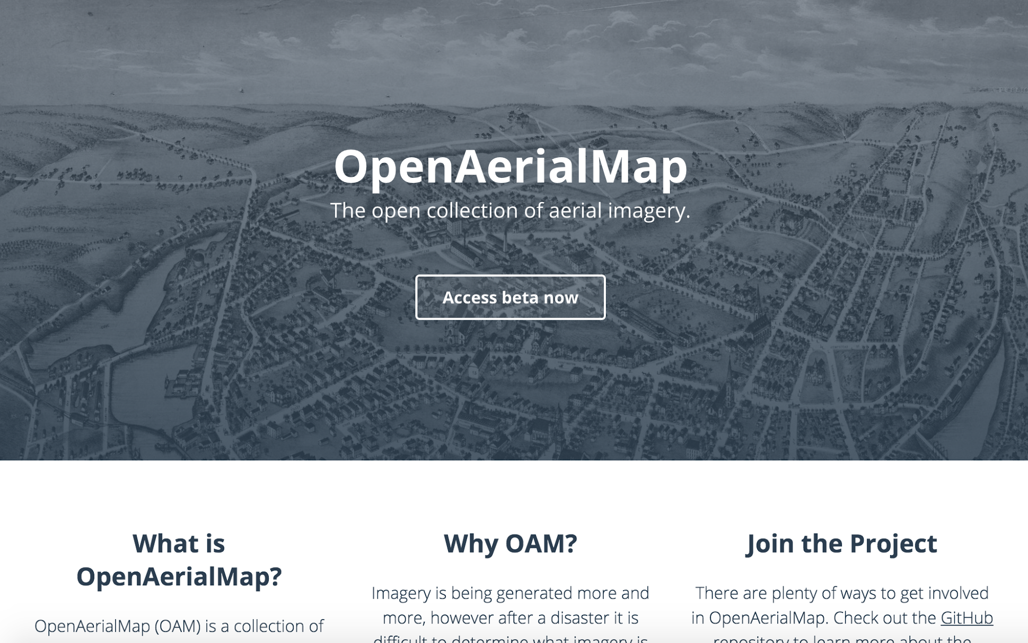
openaerial.org
https://github.com/hotosm/OpenAerialMap

Slide 36
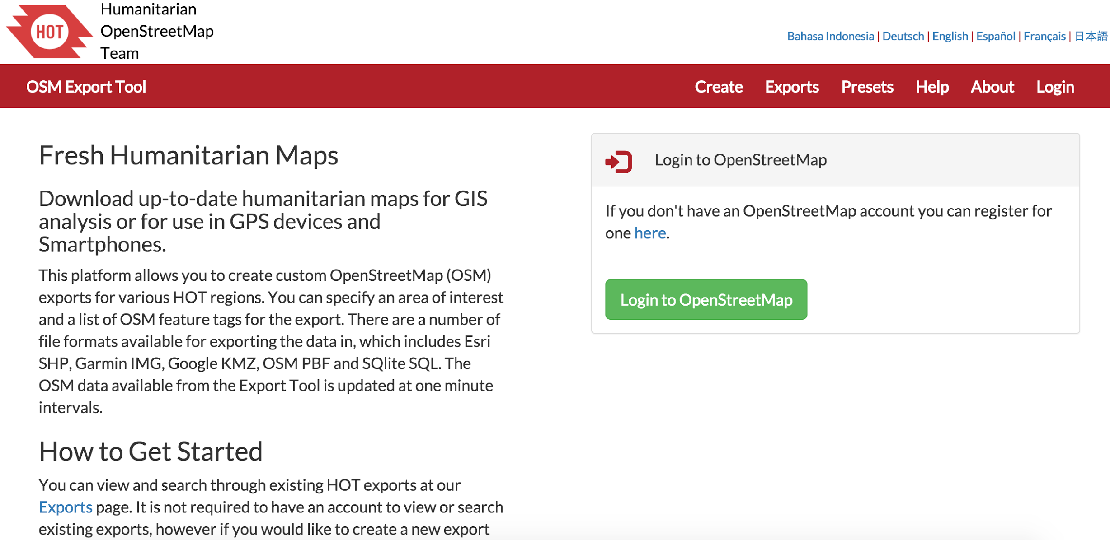
HOT Export Tool
http://export.hotosm.org/

Slide 37


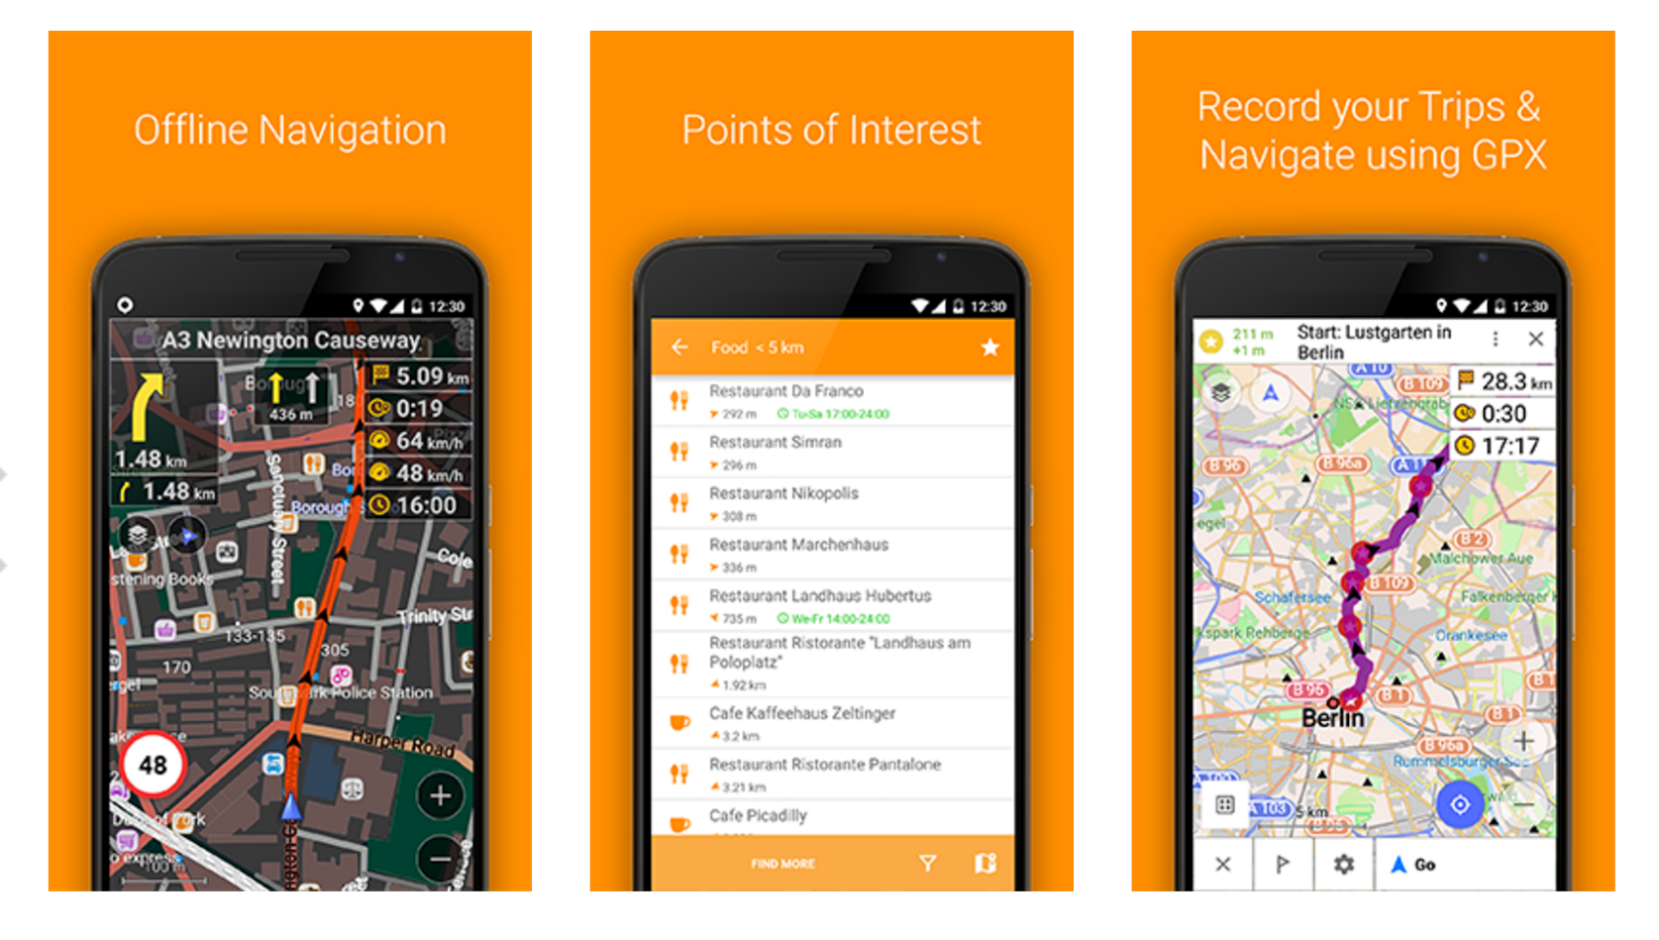

OSM data in different file formats

Slide 38

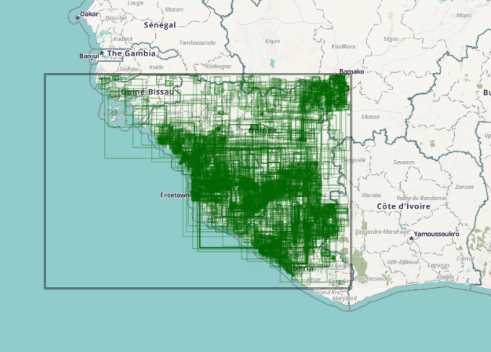
2014
2015
2016
Hewlett Foundation
Grant towards the West Africa Ebola Epidemic

Slide 39
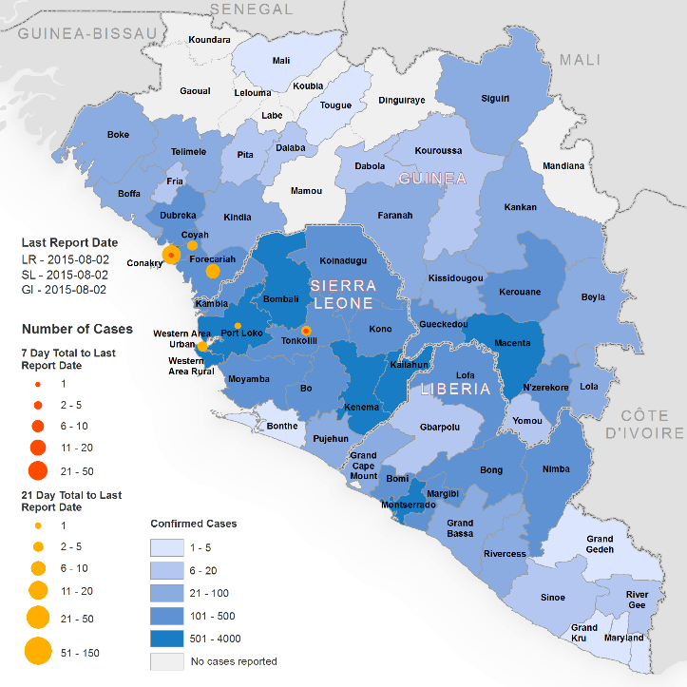
Western Africa Ebola Epidemic
More than 11,000 victims
from 2014 - 2o15
Situation report
5 August 2015
Courtesy World Health Organization (WHO)
Notes:
More than 11,000 people have died in the 2014-2015 west Africa outbreak as of August 5, 2015

Slide 40
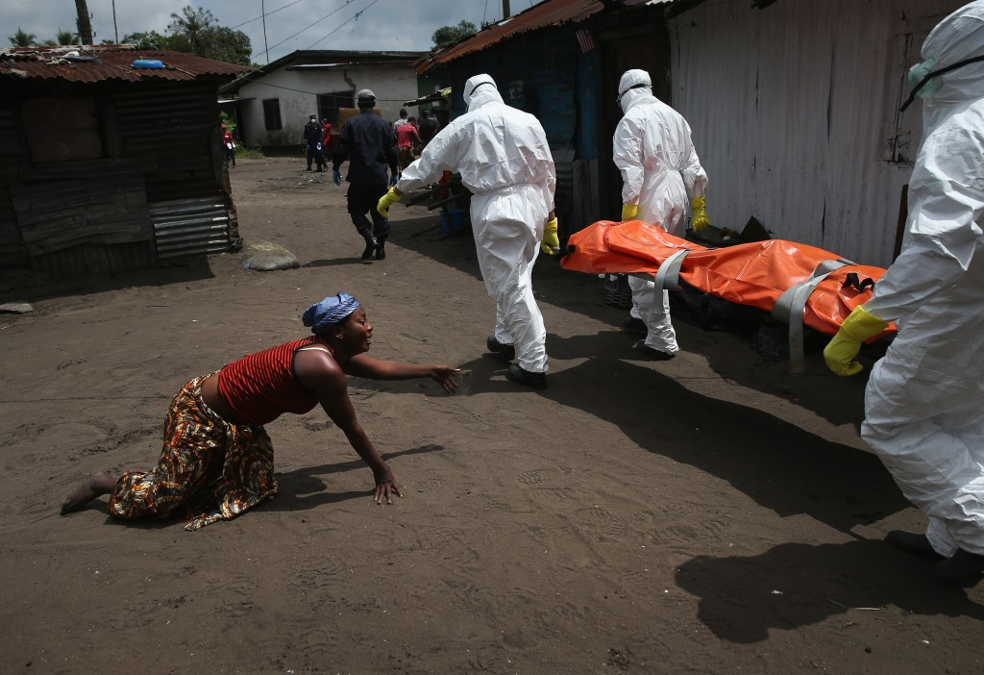
Photo: John Moore, Getty Images | Appeared in PBS Newshour article 10/14/2014
Notes:
Story of sadness
One of the most awful things about Ebola is the separation it creates – disrupts normal care for sick, grieving
Physical disconnect between doctor and patient, between husband and wife, in this case – sister and sister
Not being able to bury a loved one.

Slide 41
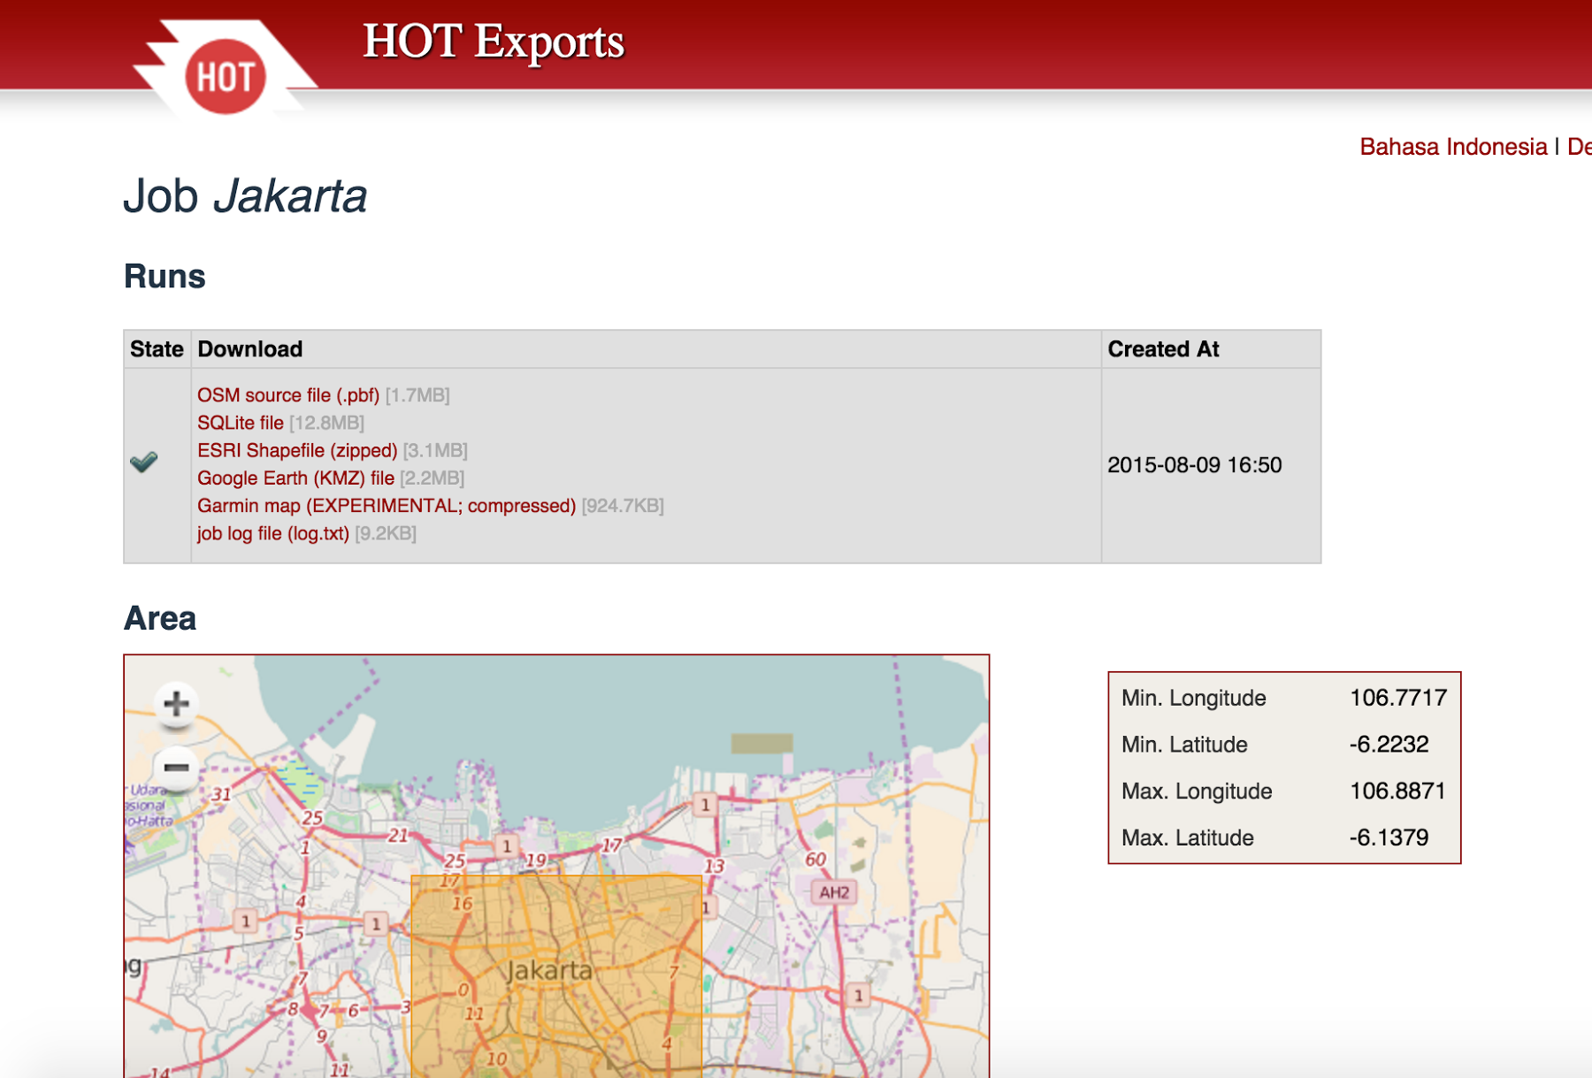
Export Tool V1. 2012
Developed by HOT + Geofabrik, with funding from USAID and the World Bank

Slide 42
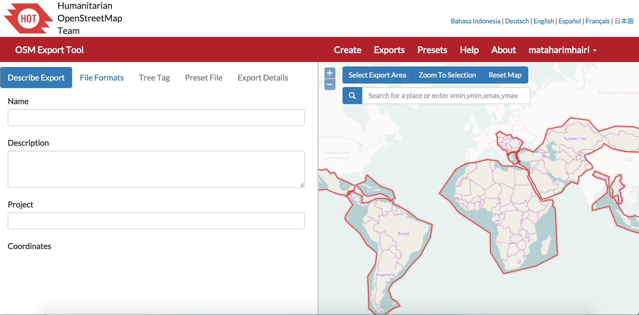
3 Main Sections:
Create, Exports + Presets

Slide 43
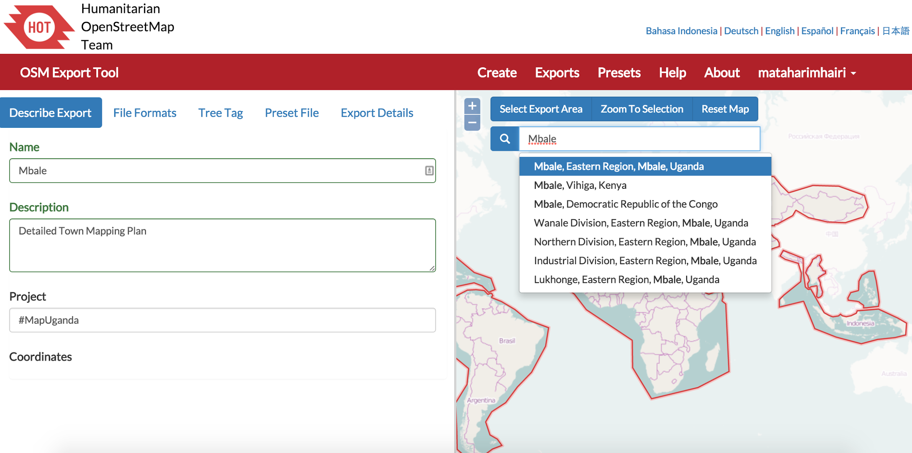
Create: Describe Export Tab
Enter name, description, project
select area of interest

Slide 44
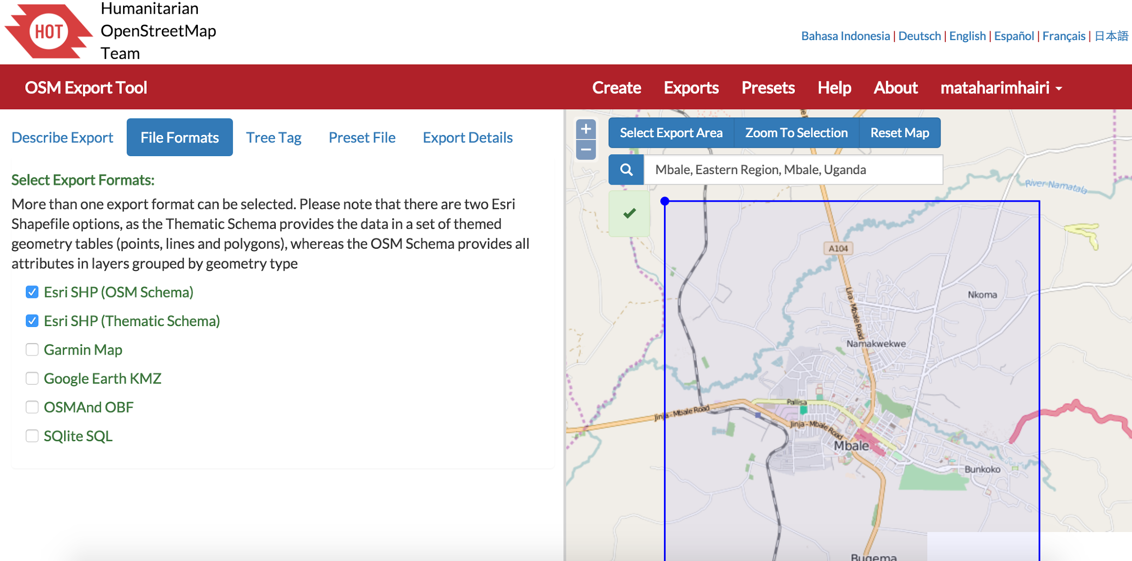
Create: File Formats Tab
Select format OSM data will be exported to

Slide 45
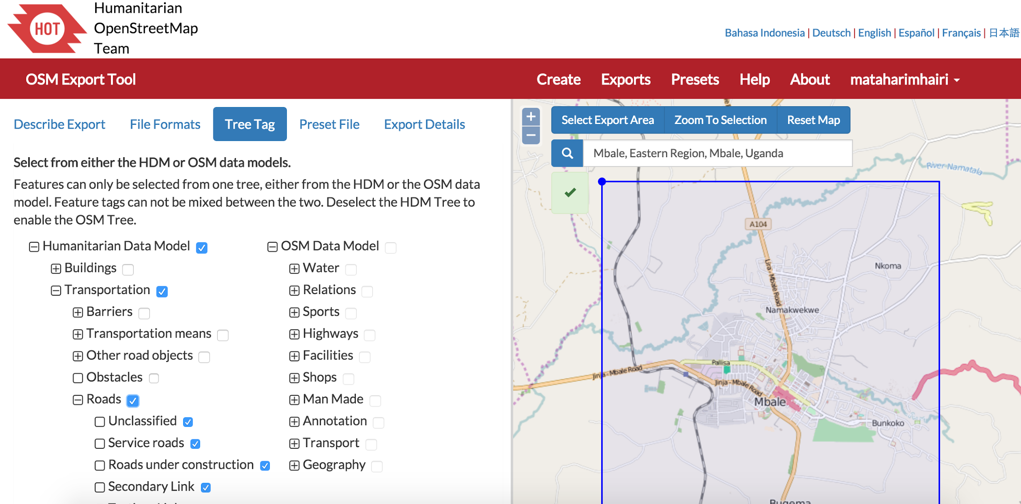
Create: Tree Tag Tab
Select features to export from either
the HDM or OSM Data Model

Slide 46
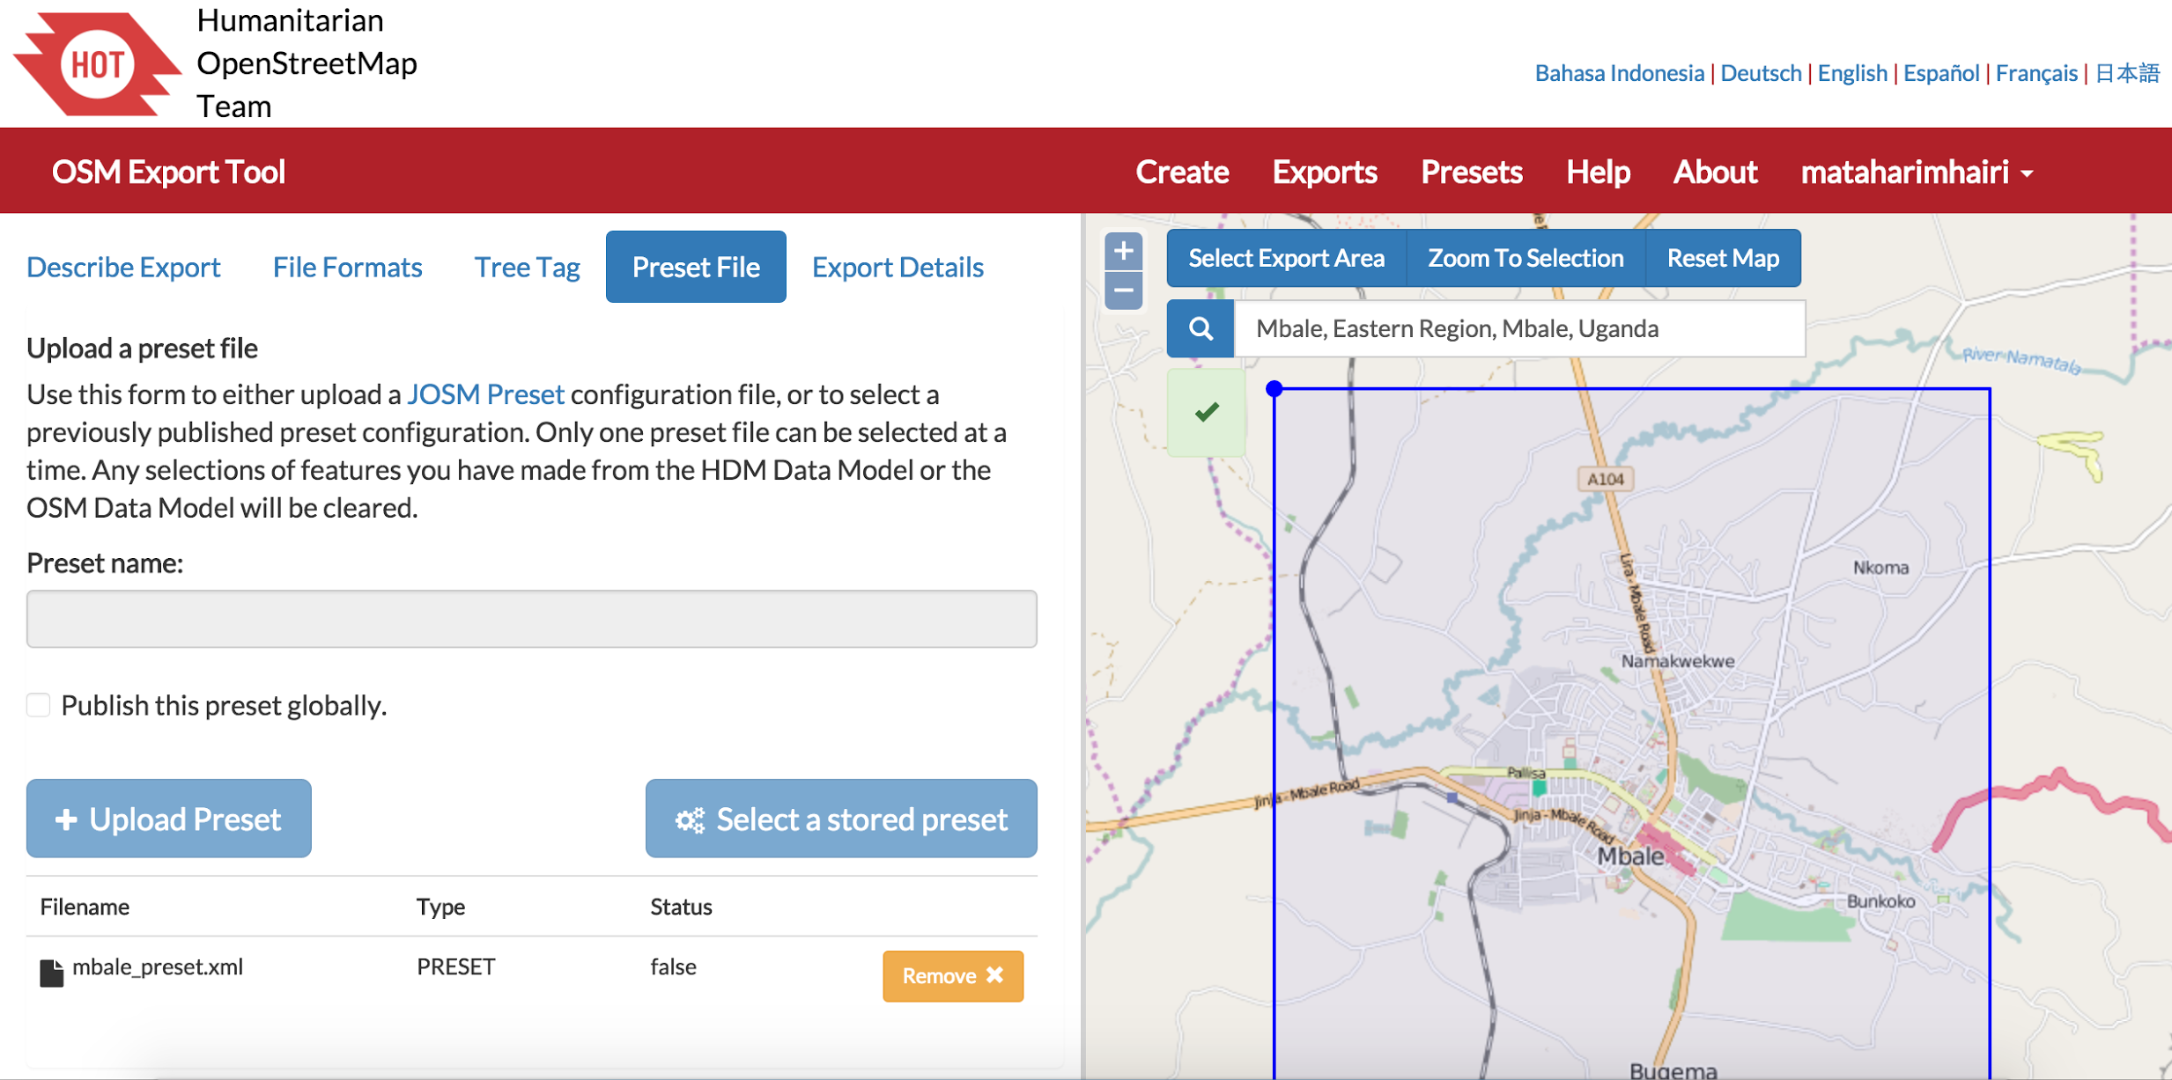
Create: Preset File Tab
Either upload or select a stored preset
to filter OSM features during export

Slide 47
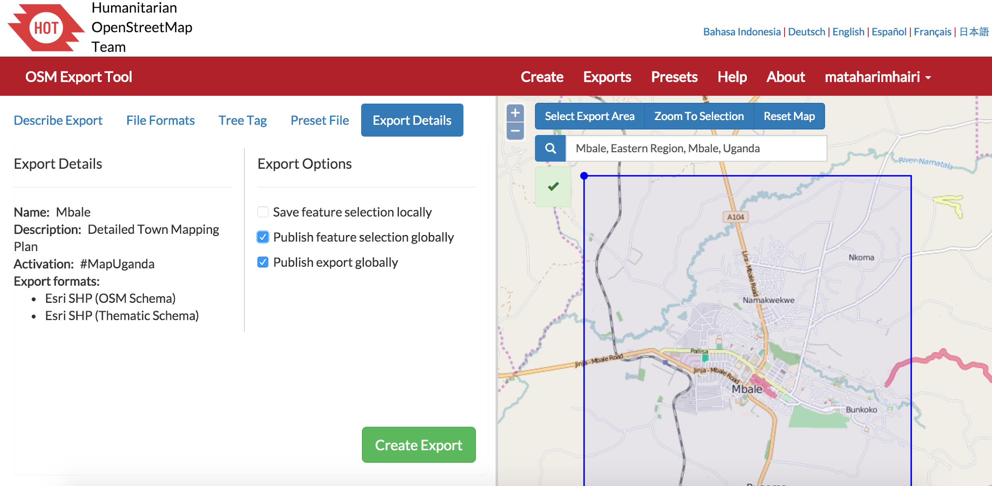
Create: Export Summary Tab
Save and publish feature selection
export either privately or publicly

Slide 48
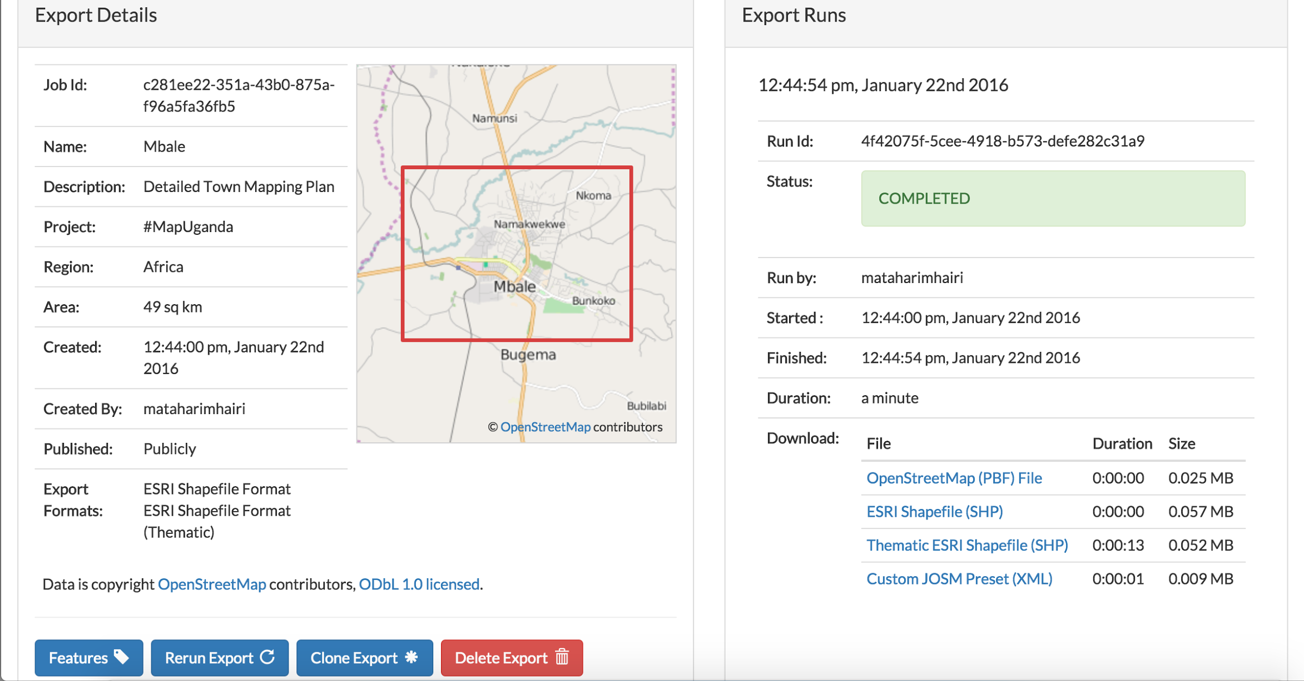
Export Details
Links to exported data files
Rerun, clone or delete export option

Slide 49
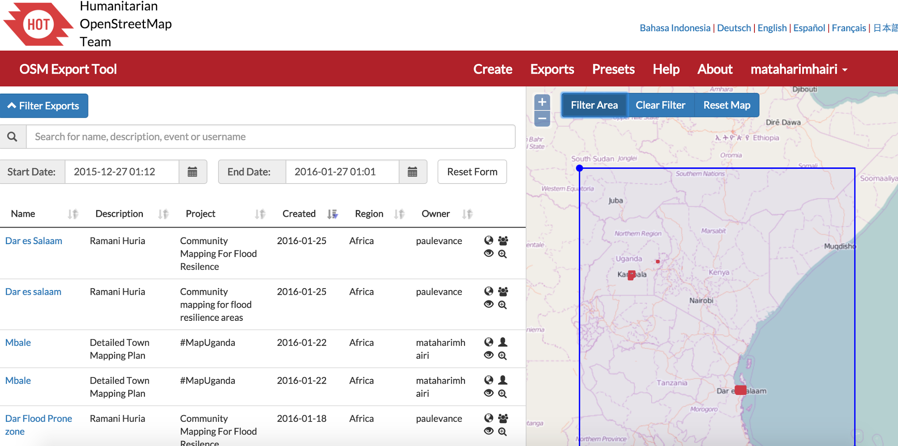
Exports
Filter + access saved exports

Slide 50
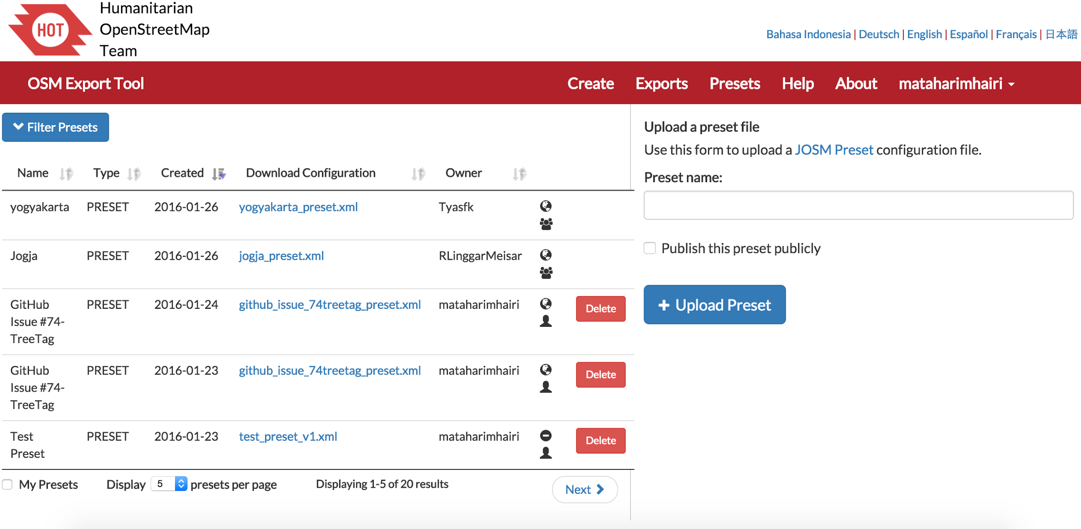
Presets
Filter + access saved presets

Slide 51
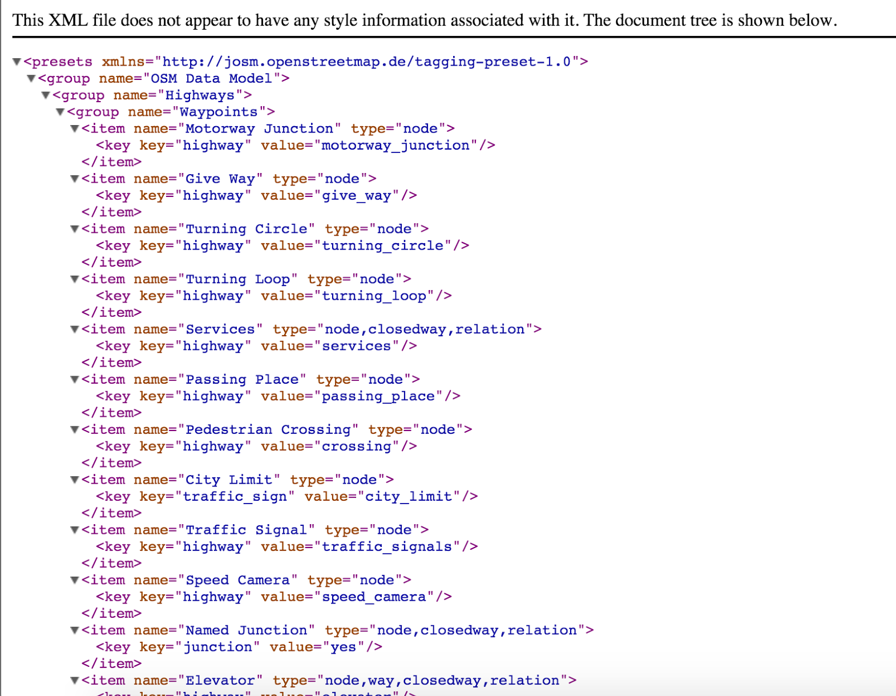
XML Preset File

Slide 52
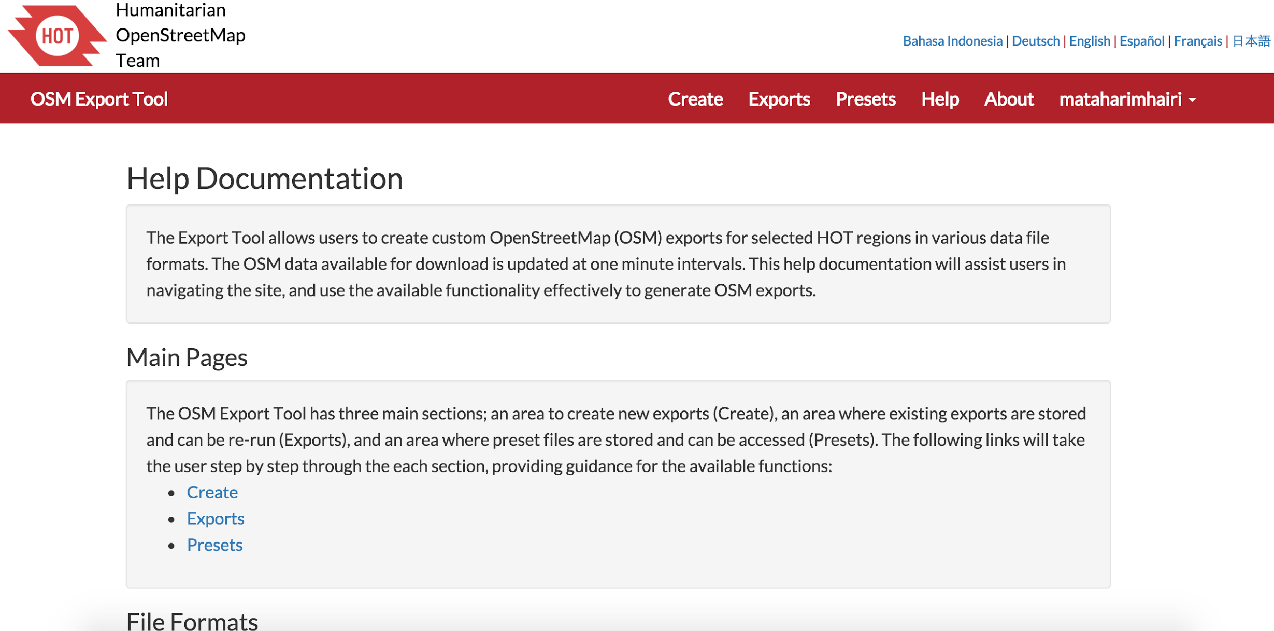
Help Documentation

Slide 53
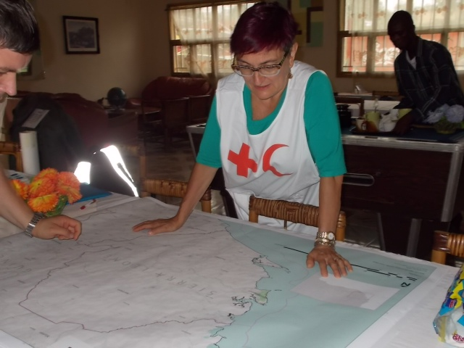
International Red Cross and Red Cresent
Using OpenStreetMap to coordinate their volunteers

Slide 54

OSM Data on Garmin Devices

Slide 55
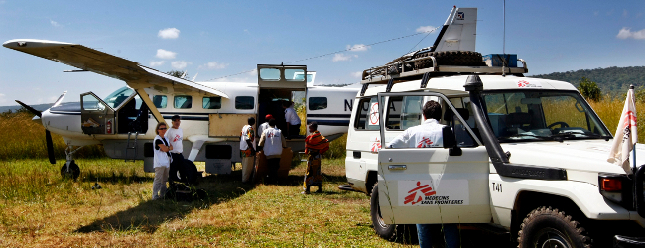
Medecins Sans Frontieres heading out
(Doctors Without Borders)

Slide 56
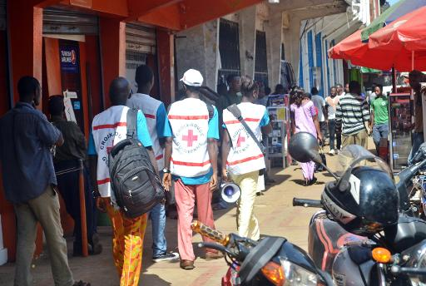
Moving the right people, medicine, and equipment to the right place at the right time

Slide 57
Ebola outbreak officially ended in Sierra Leone in November; Guinea in December, and Liberia on 14 January 2016
World Health Organisation

Slide 58
Export Tool Architecture

Slide 59
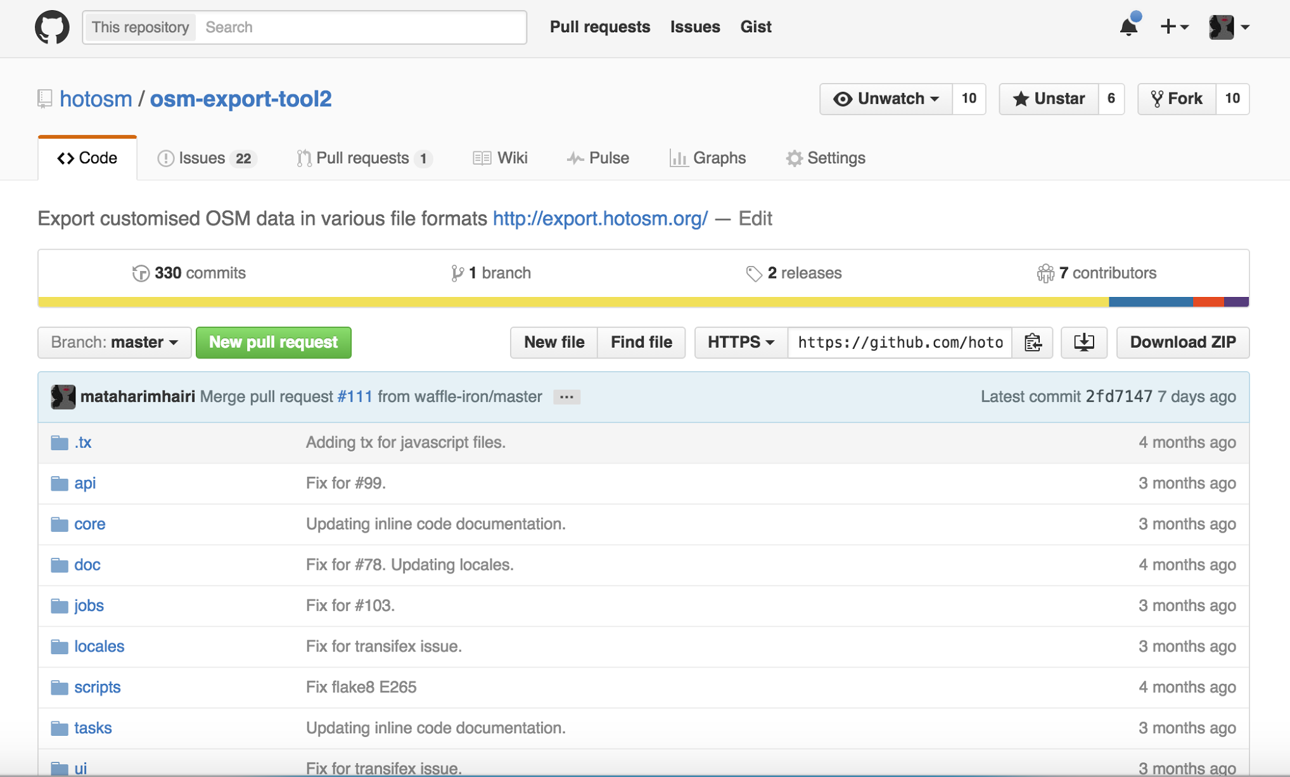
GitHub Repository
https://github.com/hotosm/osm-export-tool2/

Slide 61


Additional File Formats
i.e. MapsMe
Open Tool to Export all Regions
GitHub Issues

Slide 62
Get Involved
HOT Mailing List
hot@openstreetmap.org
HOT Technical WG
techwg@hotosm.org
https://hotosm.org/

Slide 63


HOT Summit 2016
State of the Map
Brussels, Belgium

